Slide 1
Portfolio Website
Sebastian Cappadonna

Slide 2
Objective of the Website
The project’s objective was created in order to display my work as an Editor, Graphic Designer and Front-End developer, in order to provide an organized way for potential clients.

Slide 3
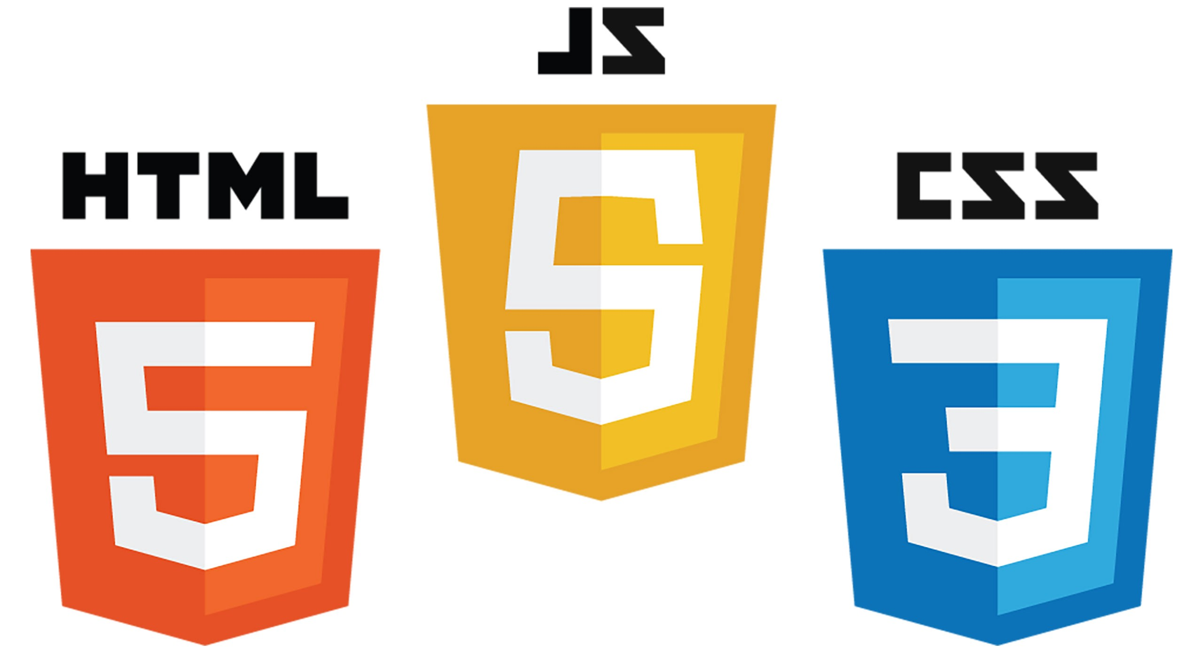


Languages and Frameworks Used For Creation
Languages
HTML
CSS
JavaScript
Frameworks
Bootstrap
ScrollReveal.js

Slide 4

Service used for Hosting and Management of the Website
Netlify - is an all-in-one platform for automating modern web projects.
https://app.netlify.com/

Slide 5
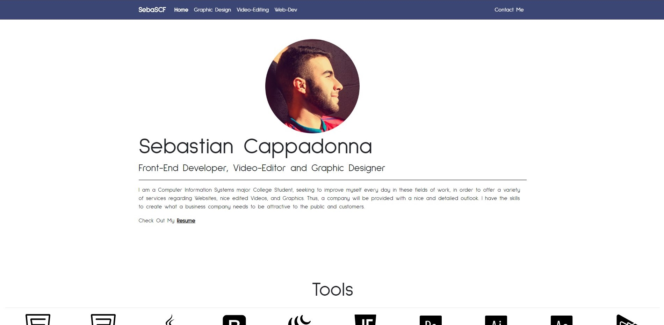
Let’s Demonstrate the Website

